Slide 1
SOEN 384
Management, Measurement and Quality Control http://users.encs.concordia.ca/~s384_2/
Refactoring and Code Smells

Slide 2
What is Refactoring?
The process of changing a software system in such a way that it does not alter the external behavior of the code yet improves its internal structure.
Notes:
May not cause a failure of a project

Slide 3
Smells: Technical Reasons for Refactoring
Usually, code smells are structural characteristics of software that may indicate a code or design problem that makes software hard to evolve and maintain, and may trigger refactoring of code.

Slide 4
Some Source Code Smells
Duplicated Code
Feature Envy
Long Method
Long Class
Switch Satements
Data Class

Slide 5
Duplicated Code
Duplicated Code means that the same code structure appears in more than one place.
class Customer extends Person
{
public int getAge()
{
return currentYear- this.getBirthYear();
}
…
}
class Vendor extends Person
{
…
public int getAge()
{
return currentYear- this.getBirthYear();
}
}
…
}

Slide 6
Duplicated Code
To delete this duplication we can move the getAge() method in the parent class, and we remove the method on subclasses.
class Person
{
public int getAge()
{
return currentYear- this.getBirthYear();
}
…
}
Refactoring Strategies
- Pull up method
- Extract method
- Substitute algorithm
Notes:
Pull up method:You have methods with identical results on subclasses.
Extract method: Turn the fragment into a method whose name explains the purpose of the method.

Slide 7
Feature Envy
A method is more interested in other class(es) than the one where it is currently located.
This method is in the wrong place since it is more tightly coupled to the other class than to the one where it is currently located.

Slide 8
Feature Envy
public class Phone
{
private final String unformattedNumber;
public Phone(String unformattedNumber)
{ this.unformattedNumber = unformattedNumber; }
public String getAreaCode()
{ return unformattedNumber.substring(0,3); }
public String getPrefix()
{ return unformattedNumber.substring(3,6); }
public String getNumber()
{ return unformattedNumber.substring(6,10); }
}
public class Customer
{
private Phone mobilePhone;
public String getMobilePhoneNumber()
{
return "(" + mobilePhone.getAreaCode() + ") " + mobilePhone.getPrefix() + "-" + mobilePhone.getNumber();
}
}

Slide 9
Feature Envy
public class Phone {
private final String unformattedNumber;
public Phone(String unformattedNumber)
{ this.unformattedNumber = unformattedNumber;}
private String getAreaCode()
{ return unformattedNumber.substring(0,3);}
private String getPrefix()
{ return unformattedNumber.substring(3,6);}
private String getNumber()
{ return unformattedNumber.substring(6,10);}
public String toFormattedString()
{ return "(" + getAreaCode() + ") "
+ getPrefix() + "-" + getNumber();
}
}
public class Customer{
private Phone mobilePhone;
public String getMobilePhoneNumber() {
return mobilePhone.toFormattedString();
}
}
Refactoring Strategies
MoveMethod
ExtractMethod
ExtractClass
Notes:
MoveMethod when the whole method clearly wants to be elsewhere, or
ExtractMethod when only part the method is envious...or even
ExtractClass if there are several envious methods and the functionality doesn't quite belong in the other object either.

Slide 10
Long Method
A method that is too long, so it is difficult to understand, change, or extend.
public void printAccountDetails(Account account) {
//print summary
System.out.println ("Name:" + account.getName());
System.out.println ("Balance" + account.getBalance();
//print history
for(Iterator iterator=account.getTransactions().iterator();iterator.hasNext();)
{
Transaction tx=(Transaction)iterator.next();
System.out.println("Type:"+tx.getType()+
"Date"+tx.getDate().toString()+
"Amount"+tx.getAmount().toString());
}
}

Slide 11
Long Method
public void printAccountDetails(Account account) {
printSummary(account);
printHistory(account);
}
private void printSummary(Account account)
{
System.out.println ("Name:" + account.getName());
System.out.println ("Balance" + account.getBalance();
}
private void printHistory(Account account)
{
for(Iterator iterator=account.getTransactions().iterator();iterator.hasNext();)
{
Transaction tx=(Transaction)iterator.next();
System.out.println("Type:"+tx.getType()+
"Date"+tx.getDate().toString()+
"Amount"+tx.getAmount().toString())
}
}
Refactoring Strategies
- Extract method
- Move method

Slide 12
Long Class
A class is trying to do too much. These classes have too
many instance variables or methods.
Class Order
{
private String customer_firstname;
private String customer_lastname;
private String customer_company_name;
private String customer_address;
private String customer_city;
private String customer_country;
private String customer_phonenumber;
private String customer_faxnumber;
private String customer_email;
private String customer_$vat;
private String order_id;
private String order_number;
private String order_total_price;
private String order_date;
private String order_shipping_date;
private String payment_transaction_id;
private String payment_type;
...
}

Slide 13
Long Class
class Customer
{
private String firstname;
private String lastname;
private String company_name;
private String address;
private String city;
…
}
Class Payment
{…}
Class Order
{…}
Refactoring Strategies
- Extract class
- Extract subclass
Notes:
Create a new class and move the relevant fields and methods from the old class into the new class

Slide 14
Switch Statements
Often you find the same switch statement scattered about a program in different places. If you add a new clause to the switch, you have to find all these switch statements and change them.
Often the switch statement switches on a type code
double getSpeed()
{
switch (_type)
{
case EUROPEAN:
return getBaseSpeed();
case AFRICAN:
return getBaseSpeed() - getLoadFactor()
* _numberOfCoconuts;
case NORWEGIAN_BLUE:
return (_isNailed) ? 0 : getBaseSpeed(_voltage);
}
throw new RuntimeException ("Should be unreachable");
}

Slide 15
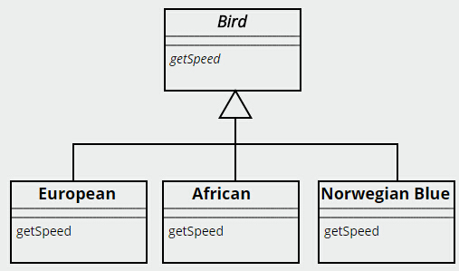
Switch Statements
Refactoring Strategies
-polymorphism

Slide 16
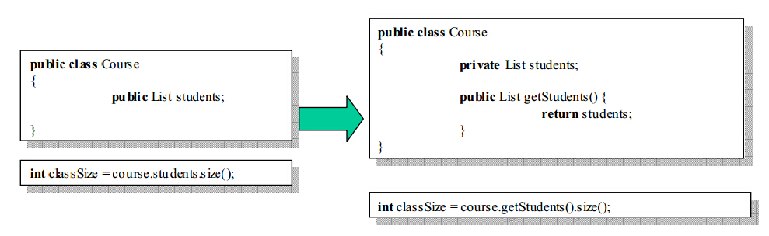
Data Class
Un-encapsulated data is an absolute no-no in OO application design. Use getter and setter to provide public access to these attributes.

Slide 17
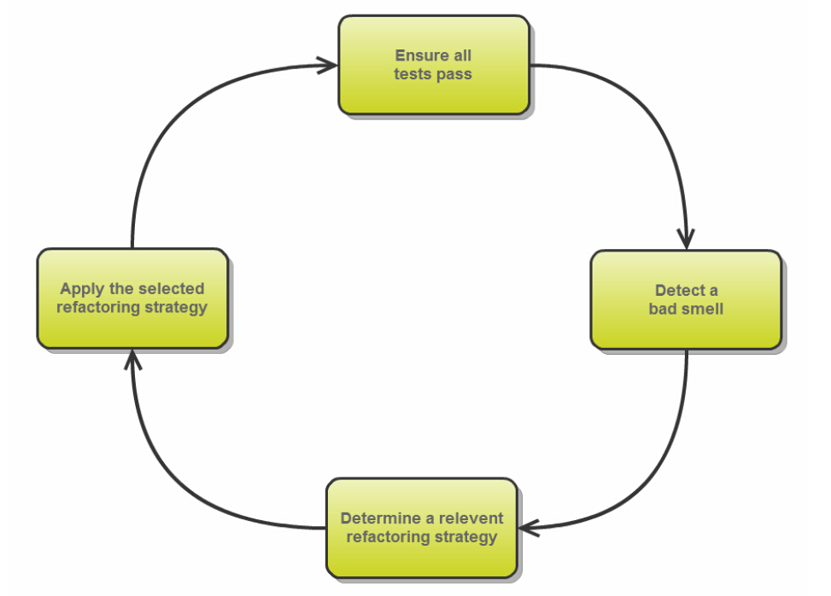
Refactoring Process

Slide 18
Signs When Once Needs to Refactor
The Rule of Three
When the Code smells
When you add functionality
Some Legacy Systems
Notes:
if you do three things the same time in an implementation, its time to refactor to avoid more repetition in the future

Slide 19
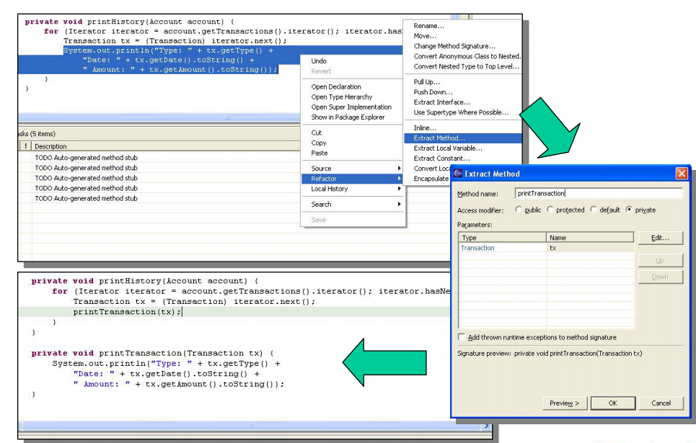
Tools: Eclipse for Refactoring

Slide 20
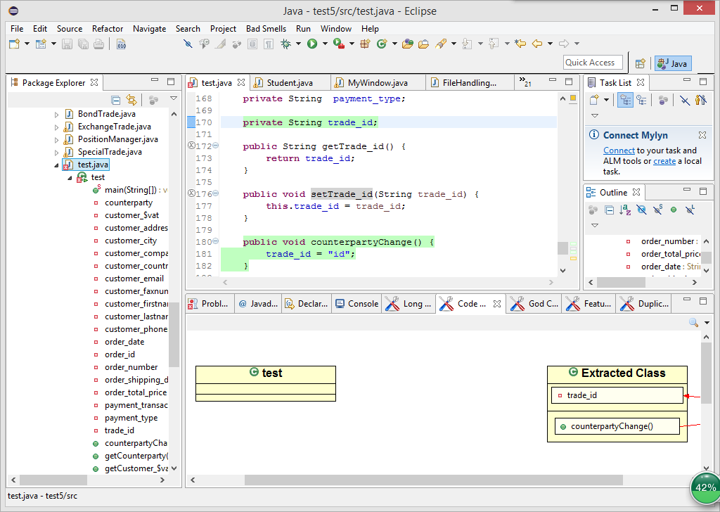
Tools: JDeodorant
JDeodorant is an Eclipse plug-in that identifies design problems in software, known as bad smells, and resolves them by applying appropriate refactorings. It can detect smells: Feature Envy, Long Method, Switch Satements, and Long Class.

Slide 21
References
Francesca Arcelli Fontana, Pietro Braione, and Marco Zanoni. Automatic detection of bad smells in code: An experimental assessment. Journal of Object Technology, 11(2):5:1–38, August 2012.
http://www.refactoring.com/catalog/
http://users.encs.concordia.ca/~nikolaos/jdeodorant/

